Slide 1

AKASHA PARYATANAM

Slide 2
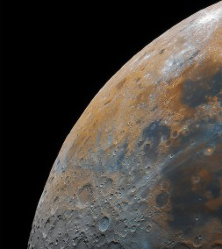
ABOUT US
Welcome to Akasha Paryatanam, your gateway to the stars and beyond. As an Indian space tourism agency, we are dedicated to making the cosmos accessible to everyone. With a passion for exploration and a commitment to excellence, we offer unparalleled experiences that transcend Earth's boundaries.
Our team of space enthusiasts, engineers, and experts collaborates tirelessly to curate unforgettable journeys. From the mystical Moon to the majestic gas giants Saturn and Jupiter, and the enigmatic Red Planet Mars, we bring the universe closer to you, all while ensuring your safety and comfort.

Slide 3

TRAVEL PACKAGES OFFERED
Mars Expedition
Lunar Getaway
Saturn's Splendor
Jupiter Odyssey
Galactic Grand Odyssey: Mars, Moon, Saturn, and Jupiter Expedition

Slide 4
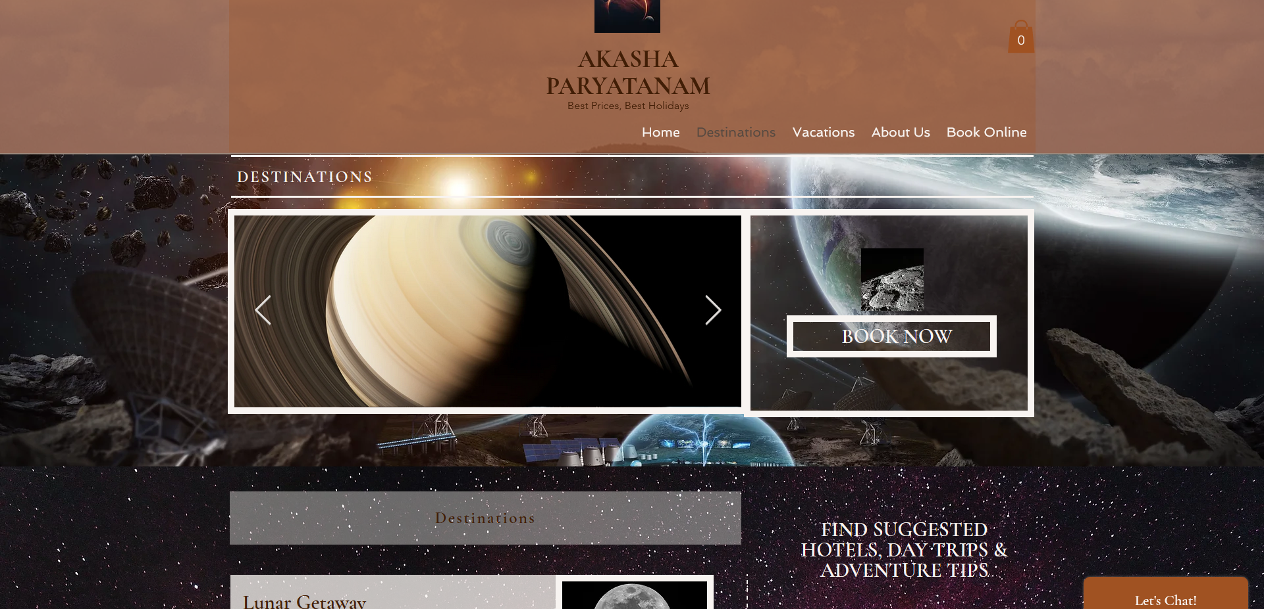
To reserve your tour tickets, please go to https://athlkmrr.wixsite.com/akashaparyatanam.

